Slide 1
Tsinghua University Economic History and Development in Latin America Instructor: Prof. Lucas Llach (affiliation: Universidad Torcuato Di Tella, Argentina) Lecture 3/8. Independence and Instability in Post-Independence Latin America

Slide 2
Roadmap
Recap of the Colonial Economy
Independence and the Colonial Heritage
Institutional theories
Dependency theories
Endowment theories
Performance During the Post Independence Decades

Slide 3
Roadmap
Recap of the Colonial Economy
Independence and the Colonial Heritage
Institutional theories
Dependency theories
Endowment theories
Performance During the Post Independence Decades

Slide 4
The Colonial Economy: the Basics
An economy subservient to the Empire. Types of economies:
Mining economies (parts of Mexico & Peru, present-day Bolivia, Brazil in the 1700s).
Plantation economies: the Caribbean, Brazil, parts of Colombia.
Population economies (parts of Mexico & Peru)
"Empty spaces" eventually agricultural: Argentina, Uruguay, parts of Chile.
Non-capitalist expoitation
Mercantilism & trade monopolies

Slide 5
The Colonial Economy: some questions 1. Did Europe benefit?
Spain: Y ansí el no haber oro ni plata, en España, es por averlo, y el no ser rica es por serlo. ("And thus there's no gold or silver in Spain beacuase there is so much; and Spain is not rich for it being so rich").
Other potential channels of "contribution":
Profits from trade in general (Marx) and the slave trade in particular (Eric Williams) financed the industrial revolution.
Demand for manufactures (but intra-European trade still dominates).
"Specie" for payments to Eastern Europe and Asia.
Supply of critical inputs for the industrial revoluton (eg, cotton)

Slide 6
The Colonial Economy: some questions 2. Why was Empire stable?
Costly land empires, not really interesting for foreign powers.
Diversity & distance. Conflicts tended to be local
"Checks and balances" between royal officials and colonial elites. This was changed by events in Europe in the early 1800s.

Slide 7
The Colonial Economy: some questions 3. How Was Economic Performance and Why?
Static gains:
"Frontier effect" of new technologies
"Terms of trade"-driven wealth
Dynamic drags:
Land tenure systems
Castas system: República de Indios v República de Españoles and its effect on labor markets
Intrincate and discriminatory judicial system.

Slide 8
Roadmap
Recap of the Colonial Economy
Independence and the Colonial Heritage
Institutional theories
Dependency theories
Structural theories
Performance During the Post Independence Decades

Slide 9
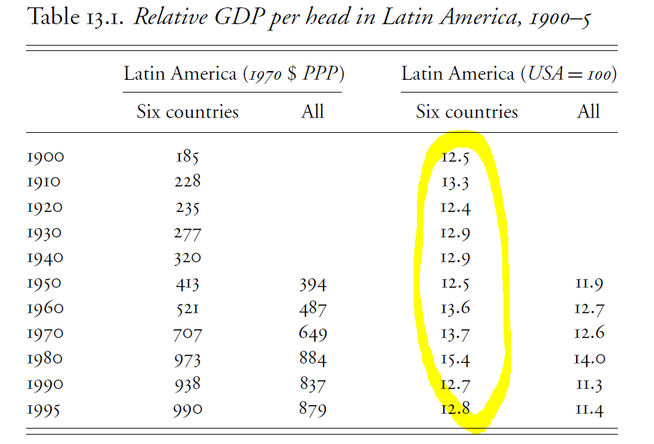
If divergence vs USA wasn't in the 20th century, it probably was the 19th...

Slide 10
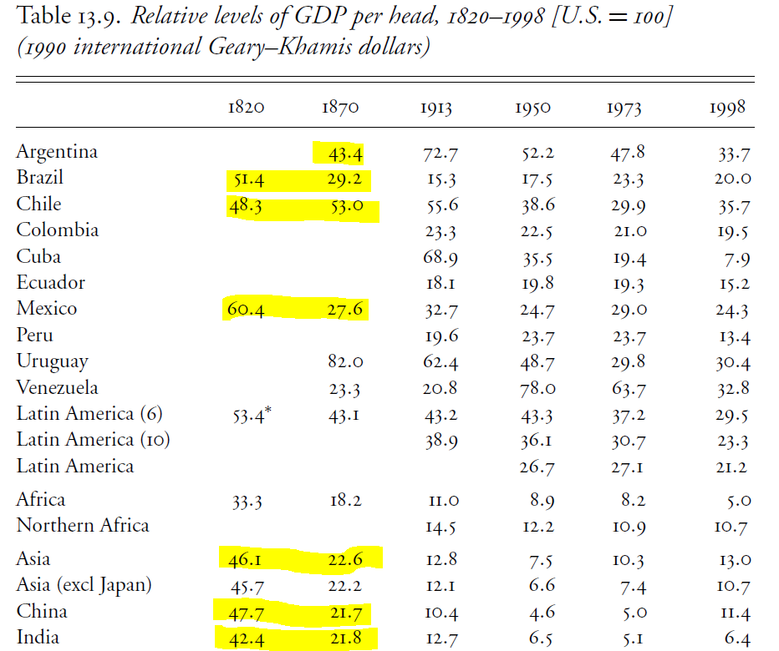
... but it was a global "periphery" phenomenon

Slide 11
Institutional Theories (1): The "identity of the colonizer" hypothesis
USA / Canada vs. Latin America...
...but: Jamaica, Guiana and other British Caribbean territories.

Slide 12
Insitutional Theories (2) Engerman/Sokoloff and "factor endowments"
Factor endowments (resources/labor)
Income distribution
Institutions & policies
Economic performance

Slide 13
Insitutional Theories (3) Acemoglu/Robinson and settler mortality
Settler mortality
Large stock or European settlers
"European"/inclusive institutions
Economic performance
A "Reversal of Development"?

Slide 14
Roadmap
Recap of the Colonial Economy
Independence and the Colonial Heritage
Institutional theories
Dependency theories
Endowment theories
Performance During the Post Independence Decades

Slide 15
Dependency Theories
The Core-Periphery model and patterns of domination:
Technology
Capital
Terms of trade (ie., export/import prices)
Latin America: A Periphery of a Periphery? (Stanley & Barbara Stein)

Slide 16
Roadmap
Recap of the Colonial Economy
Independence and the Colonial Heritage
Institutional theories
Dependency theories
Endowment theories
Performance During the Post Independence Decades

Slide 17
Geography or "Endowments"
Endowments of "factors": land, capital, natural resources, human capital ¿distance?
Endowment, trade & income:
Heckscher-Ohlin model: a country will have comparative advantages according to factor endowments.
Stolper-Samuelson: trade will benefit factors of production that are "winners" with trade.
The role of transport costs

Slide 18
Roadmap
Recap of the Colonial Economy
Independence and the Colonial Heritage
Institutional theories
Dependency theories
Endowment theories
Performance During the Post Independence Decades

Slide 19
The shock of independence
Some shocks:
"Imperial burden" (eg., Mexico)
Terms of trade shock (eg., Argentina)
Institutional Change?
Imperial disintegration and political conflict over who would be in charge.
Was It Shock or Continuity? (eg., Brasil v Argentina)
What else was happening at the same time?
Industrial Revolution in England

Slide 20
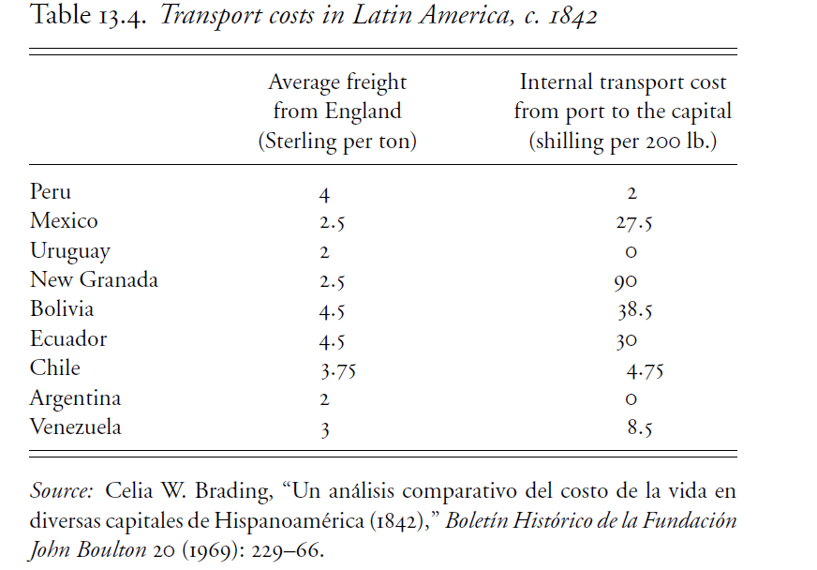
The shock of independence: differential transport costs

Slide 21
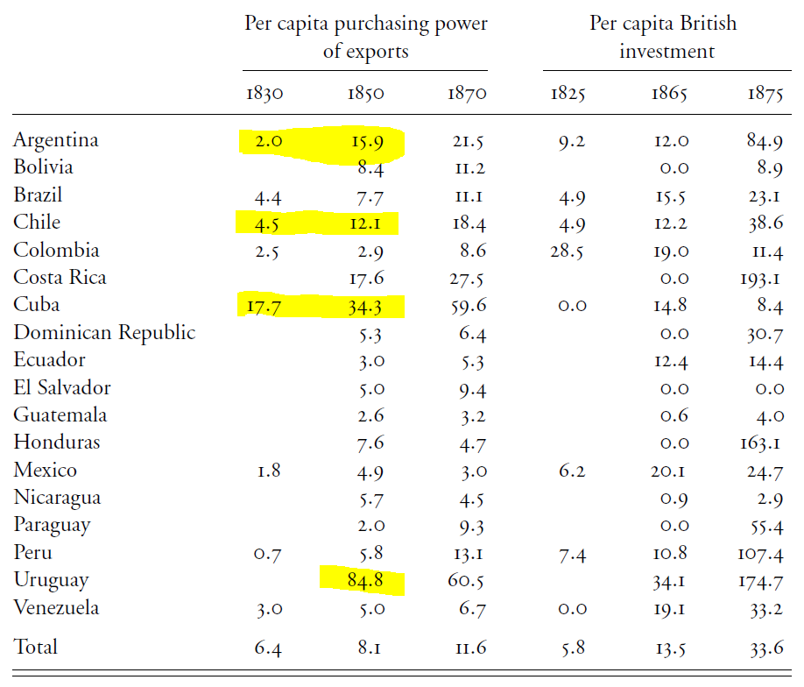
The shock of independence: differential transport costs

Slide 22
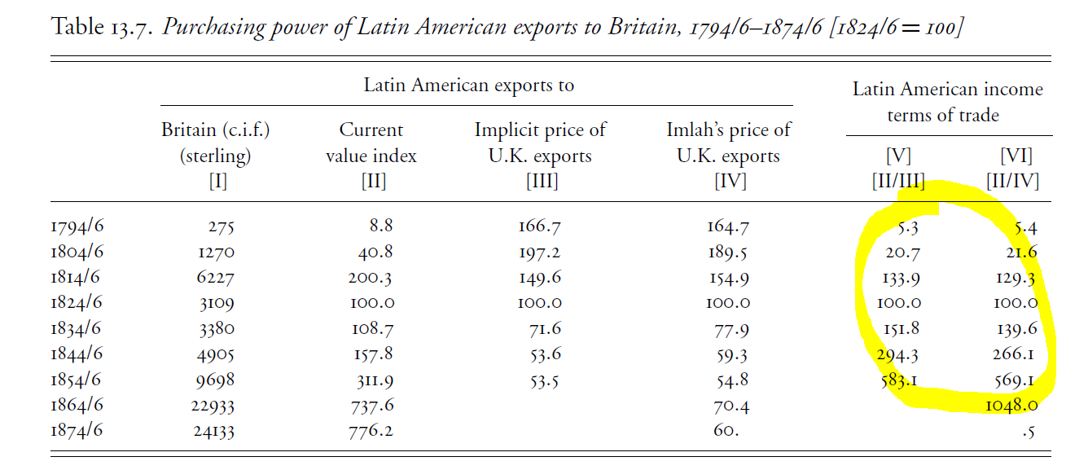
The shock of independence: improvement of terms of trade

Slide 23
The Post-Independence Economy 1. Brazil
Still an "Empire" in spite of independence.
Slave plantations until the end of the 19th century.
Obstacles to industrialization:
If it was British dependence, it predated independence.
Brazilian authorities were autonomous (eg., slave trade) but were smart to avoid a very protectionist policy.
Brazil lacked other factors of production (technology, capital) for modern manufacture to develop.
Also: was there a market for large scale manufacturing, with high transport costs and low incomes?

Slide 24
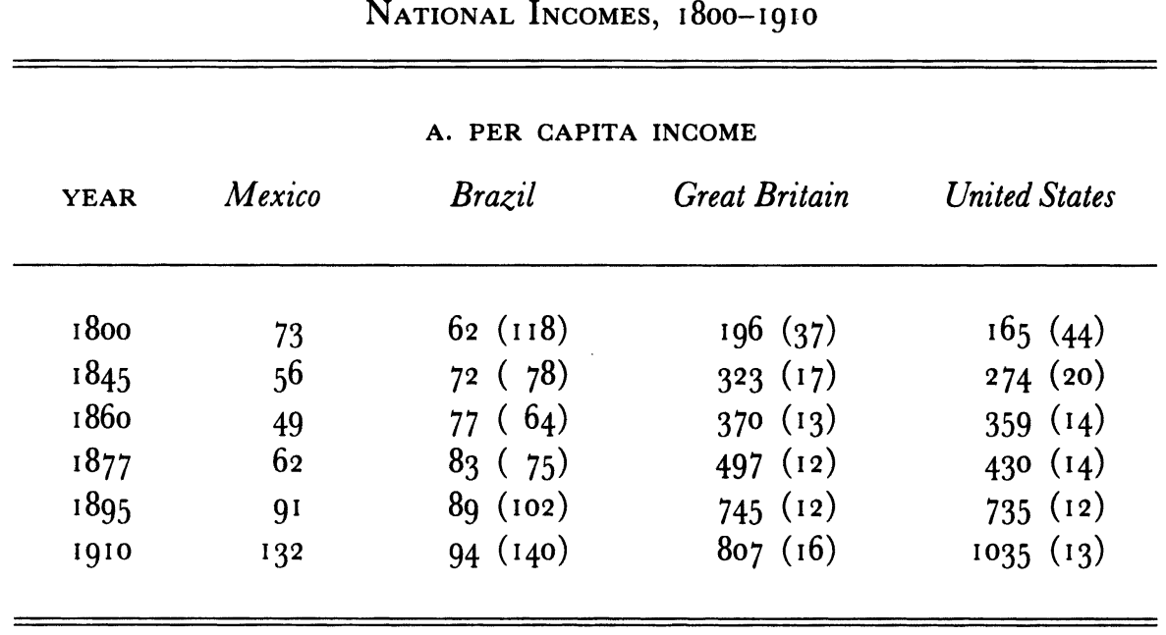
The Post-Independence Economy 2. Mexico

Slide 25
The Post-Independence Economy 2. Mexico
Marred by political conflict & low growth until the 1880s
Why?
Spanish colonial rule?
Land tenure?
The Church?
Maybe
Slow move to modern legal framework
Transport costs

Slide 26

The Post-Independence Economy 3. Argentina

Slide 27
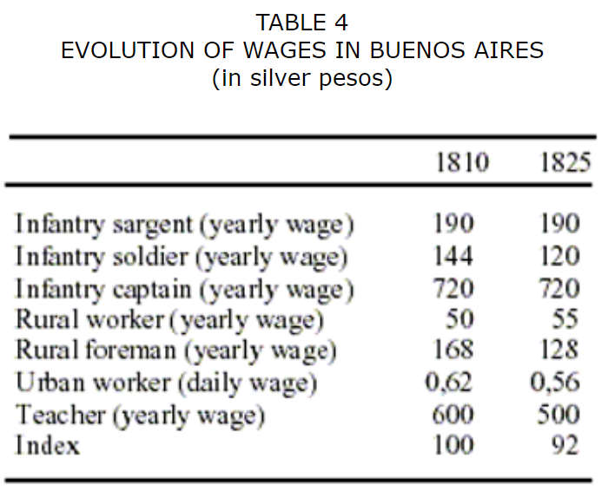
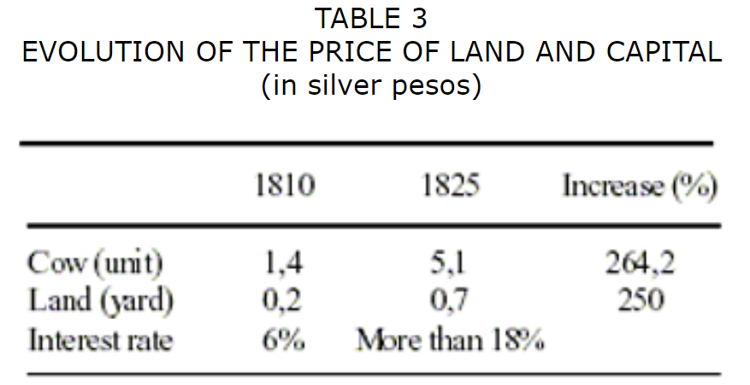
The Post-Independence Economy 3. Argentina
The more dynamic case of the three
"Disorder and Progress"
Huge terms of trade shock: effects on production (cattle) and on income distribution

